Slide 1







First National Tuberculosis Prevalence Survey South Africa 2018
27 January 2021

Slide 2
Survey Aim and Objectives
Aim
To enhance Tuberculosis control in South Africa by informing the National TB Control Programme about the current epidemiological situation of TB disease and offering insight on ways in which TB control can be improved.
Objectives
To estimate the prevalence of bacteriologically confirmed Xpert MTB/RIF Ultra and/or culture confirmed pulmonary TB disease among adults (≥15 years) in South Africa.
To identify the extent to which people with TB or with symptoms suggestive of Pulmonary TB seek care and if so, from which type of health provider.

Slide 3
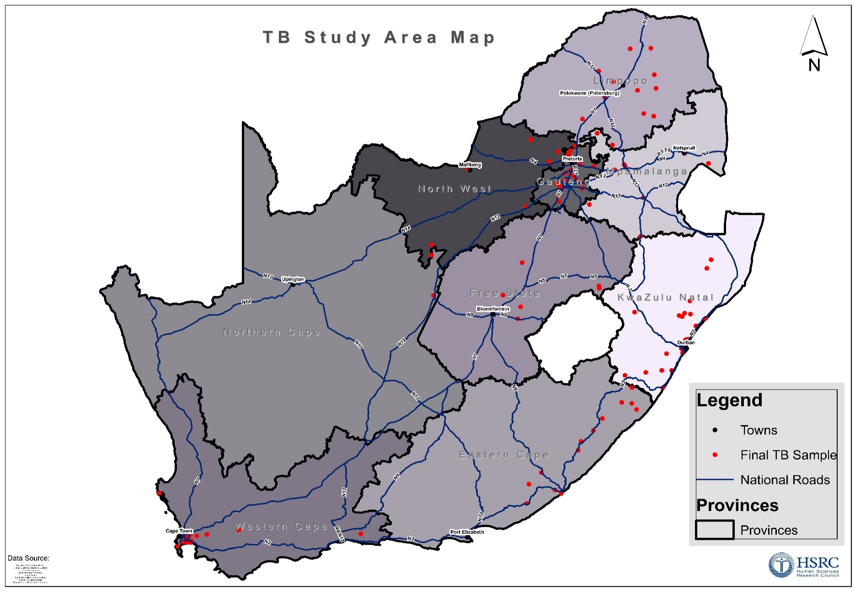
Methodology
55 000 individuals ≥15 years old
110 clusters
All nine provinces
Multistage cluster sampling
National TB prevalence survey: location and distribution of survey clusters

Slide 4
Methodology: Survey Procedures
Census at household level
*Screening at mobile field site
Sample testing at laboratory
Survey case
*≥15 years old, slept in household for ≥10 nights in preceding two weeks & provided informed consent/assent for minors

Slide 5




Methodology: Screening Algorithm
Symptoms
Cough, any duration
Unexplained weight loss
Drenching night sweats
Unexplained fever
Chest X-ray
(Radiological changes suggestive of TB)
2 Sputum specimens taken 1 hour apart
1 x Xpert Ultra
1 x MGIT
Dry blood spot sample for HIV testing (optional)

Slide 6
Flow Diagram of Survey Participants
Total population enumerated at the household level
68 771
Individuals eligible to participate at household level
35 191 (66.1% all eligible = participation rate)
Participants screened positive (symptoms+/or abnormal CXR)
9 066 (25.8% of participants) eligible for sputum collection
Valid culture result
7 305 (80.6% of screened positive)
53 250 (77.4% of enumerated)
Eligible individuals who participated
7 519 (82.9% of screened positive)
Valid Xpert Ultra result
Notes:
Trace result taken as negative

Slide 7
Participation Rate (pr) per cluster by geotype
Target participation rate (green line: 85%)
Average survey participation rate (red line 66.1%)
Lower participation in urban clusters vs rural clusters

Slide 8
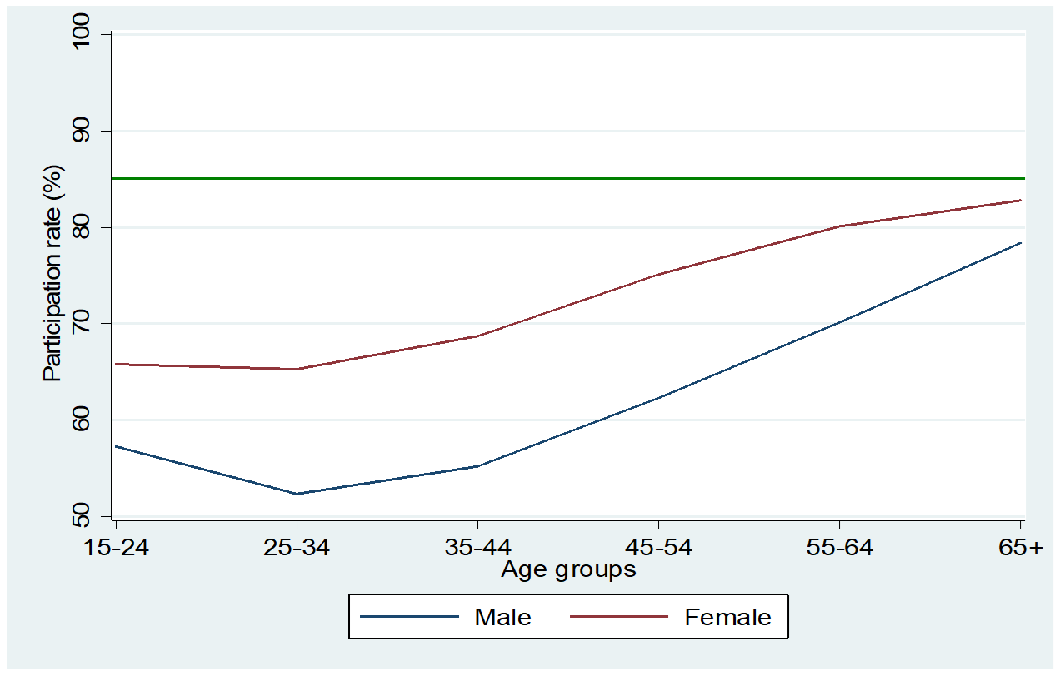
Participation by age and sex
Lower participation among young people in both sexes and across age groups
Men had lower participation rates
Target participation

Slide 9
Symptom and CXR screening among survey participants
N = 35 191, South Africa, 2018
The majority were asymptomatic & had no CXR abnormalities
Symptoms & CXR suggestive of TB
5,0%
10,1%
CXR suggestive of TB only
9,8%
Symptoms only
0,9%
CXR not done
CXR was not done because the participant declined consent for CXR, or was pregnant, or had disabilities that made it impossible to take the CXR or was bedridden and not able to attend the screening site.
74,2%
Asymptomatic & normal CXR

Slide 10
Eligibility for sputum examination
N = 9 066, South Africa, 2018
The majority were eligible by CXR abnormalities only or by symptoms only
19,1%
Symptoms & Abnormal CXR
3,7%
CRX not done
39,3%
Abnormal CRX only
37,3%
Symptoms Only
Notes:
Most eligible by symptoms only or CXR only

Slide 11
Culture and Xpert Ultra results among participants eligible for sputum examination
N = 9 066, South Africa, 2018
Culture result | Xpert Ultra result
 | Xpert positive | Xpert negative | *Not available | Total
Culture positive | 144 | 74 | 2 | 220
Culture negative | 66 | 6 460 | 60 | 6 586
**Culture Other | 13 | 752 | 1 495 | 2 260
Total | 223 | 7 286 | 1 557 | 9 066
*Xpert Ultra invalid results/ sample not processed for Ultra
**Culture other: contaminated cultures, Non-tuberculous mycobacteria, not processed for culture

Slide 12
Survey TB case definition
All culture positive cases
Plus
Xpert Ultra positive, culture not positive for Mycobacterium tuberculosis (i.e. negative, contaminated, NTM, not done)
without a history of TB (past/current)
CXR suggestive of active TB as reviewed by a CXR reading panel

Slide 13
Survey TB cases by culture and Xpert Ultra
N = 234, South Africa, 2018
Culture | Xpert Ultra |  | Total
 | Positive | Negative/ND
Positive | 144 | 76 | 220
Not Positive | 79
220 + 14
= 234 cases
History of TB: Past or current
Not a case n = 49
No history of TB: Past or current
Possible cases n = 30
CXR panel reading
CXR not suggestive of active TB-
Not a case n = 16
CXR suggestive of active TB -
a case n = 14

Slide 14
Symptoms and abnormal CXR among survey cases
N = 234, South Africa, 2018
CXR detected more cases than symptoms and signs
CXR not done
0,4%
35,0%
Symptoms & Abnormal CXR
57,8%
Abnormal CXR only
6,8%
Symptoms only
Notes:
Conclusion: CXR picked up many more cases than signs and symptoms

Slide 15
HIV status among survey participants eligible for sputum examination & among survey TB & Programme cases
HIV-positive individuals are regularly screened for TB when accessing services but there is less TB screening in HIV-negative persons
 | Participants with a known HIV status |  |  | HIV status among participants with a known HIV status
Category | Total | Known HIV status | % | HIV Negative | HIV Positive | % HIV Positive
Participants eligible for sputum examination | 9,066 | 7,061 | 77.8 | 5,414 | 1,647 | 23.3
Survey TB cases | 234 | 191 | 81.6 | 136 | 55 | 28.8
*Programme TB cases | 178 | 162 | 91.0 | 68 | 94 | 58.0
HIV status determined by a DBS result and in its absence the self-reported status.
HIV status unknown: no DBS result and no self-reported status.
*Programme TB cases: individuals already on treatment through the NTP prior to enrolment into the survey.

Slide 16
Estimated prevalence of bacteriologically confirmed
pulmonary TB (> 15 years old) by sex, South Africa, 2018
Prevalence per 100,000 |  | 95% CI
Overall | 852 | 679 - 1 026
Male | 1 094 | 835 - 1 352
Female | 675 | 494 - 855
Analyses by WHO standard methods:- multiple imputation and inverse probability weighting

Slide 17
Estimated prevalence of bacteriologically confirmed
pulmonary TB (> 15 years old) by age group, South Africa, 2018
Prevalence per 100,000 |  | 95% CI
Age group (years)
15-24 | 432 | 232 - 632
25-34 | 902 | 583 – 1 221
35-44 | 1 107 | 703 – 1 511
45-54 | 1 063 | 682 - 1 443
55-64 | 845 | 505 - 1 186
65+ | 1 104 | 680 - 1 528
Analyses by WHO standard methods:- multiple imputation and inverse probability weighting

Slide 18
Comparison of prevalent survey cases and
notified,South Africa, 2018
Estimated cases in 2018 - 390 000
Notified cases in 2018 - 235 652
Estimated missing TB patients in 2018
based on the estimated annual notifications
390 000 - 235 652 = 154 348
Cases missed in both males and females
Larger gap in males than in females
Cases missed in all age groups
Largest gaps in young people 15-24 years
and older people ≥65 years
Category | P:N ratio
Total | 1.75
Male | 1.89
Female | 1.70
15-24 years | 2.91
25-34 years | 1.61
35-44 years | 1.55
45-54 years | 1.66
55-64 years | 1.63
≥65 years | 2.88

Slide 19
Healthcare seeking among participants with symptoms of TB: % that did not seek care, South Africa, 2018
Two thirds did not seek care
Mostly younger people, males, & HIV negative

Slide 20
Reasons for not seeking care by symptomatic
survey TB cases, South Africa, 2018
*Multiple responses
(%)

Slide 21
Facility where care was sought, South Africa, 2018
Majority attended a community clinic
Private sector also utilized
Notes:
Among symptomatic survey cases 41/98 (41.8%) had sought care 31- Community clinic, 4 - Government hospital, 6 - private sector

Slide 22
Conclusions and recommendations (1)
South Africa has a high TB burden including many people with undetected TB in the community
The notification gap is especially high among those 15-24-years old, those 65 years older and in males
Strategies to detect TB in younger & older people are needed
Expanding youth friendly services and facilities & leveraging on other programmes
Explore use of technology & mhealth solutions to widen reach and facilitate entry into cascade of care
Strengthen integration of TB diagnosis and care into other chronic conditions including NCDs
Develop targeted interventions for the elderly

Slide 23
Conclusions and recommendations (2)
There is a very high burden of TB in men
TB prevalence is almost 1.6 times that of females
Strategies to reach men including
Integrating TB screening into Men’s Health programmes
Using social networks to reach men
TB is under-diagnosed among HIV-negative individuals
Systematic screening for TB among all HIV negative people accessing
health services

Slide 24
Conclusions and recommendations (3)
TB is under-diagnosed among HIV-negative individuals
Systematic screening for TB among all HIV negative people accessing
health services

Slide 25
Conclusions and recommendations (4)
Symptomatic individuals delay seeking care
Conduct in-depth behavioral assessment to determine and understand reasons for delayed care seeking
Design targeted interventions for improve health care seeking for TB symptoms and increase knowledge of TB and awareness of TB signs and symptoms

Slide 26
Conclusions and recommendations (5)
Sub-clinical TB is underestimated as a contribution to the TB burden
More survey cases were detected through chest X-ray screening than through symptom screening in this active case setting
Further research into tools to detect sub-clinical TB and appropriate treatment and management
Chest X-ray should be elevated in the active case finding algorithm

Slide 27
Limitations
The participation rate of 66.1% was below the target level of 85%
The HIV status for many participants was based on self-report
The analysis used a conservative approach to derive the estimates, given the specificity of Xpert Ultra and the high rate of false-positive results for TB disease in low prevalence settings like the survey setting.

Slide 28
Strengths
First nationally representative population-based survey providing a national estimate of the true burden of TB in South Africa
Followed WHO standardized methodology for robust estimates that can be compared to those from other countries and regions
Used WHO reference laboratory
Generated data of use in the country and globally to guide use of Xpert Ultra in active case finding settings
Notes:
Close collaboration of major public institutions in the country working with the Department of Health

Slide 29
Overall conclusion
The First National Tuberculosis Prevalence Survey, South Africa, 2018, identified a high TB burden, higher in males than in females and in individuals aged 35-44 years and 65 years and older
Many people have undetected TB in the community with the largest prevalence to notification gap among young people and the elderly.
A higher proportion of TB was detected among HIV-negative individuals, with most reporting no symptoms.
Sub-clinical TB has emerged as another area that requires further research and will be important for long term control efforts.
Many people delay seeking care for TB symptoms

Slide 30

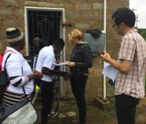

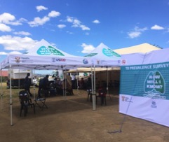
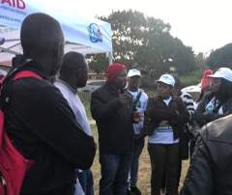
The survey was a collective effort

Slide 31
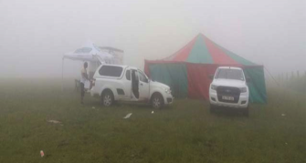

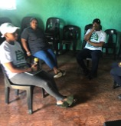
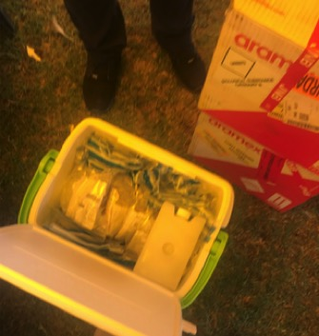

Slide 32
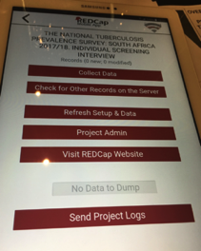
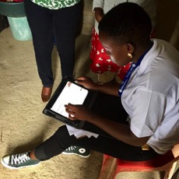
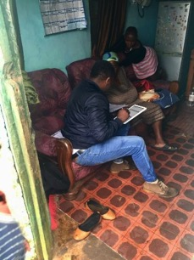
Using tablets linked to a central server
But paper back up still required if
internet is down!
Notes:
Photo by Irwin Law

Slide 33
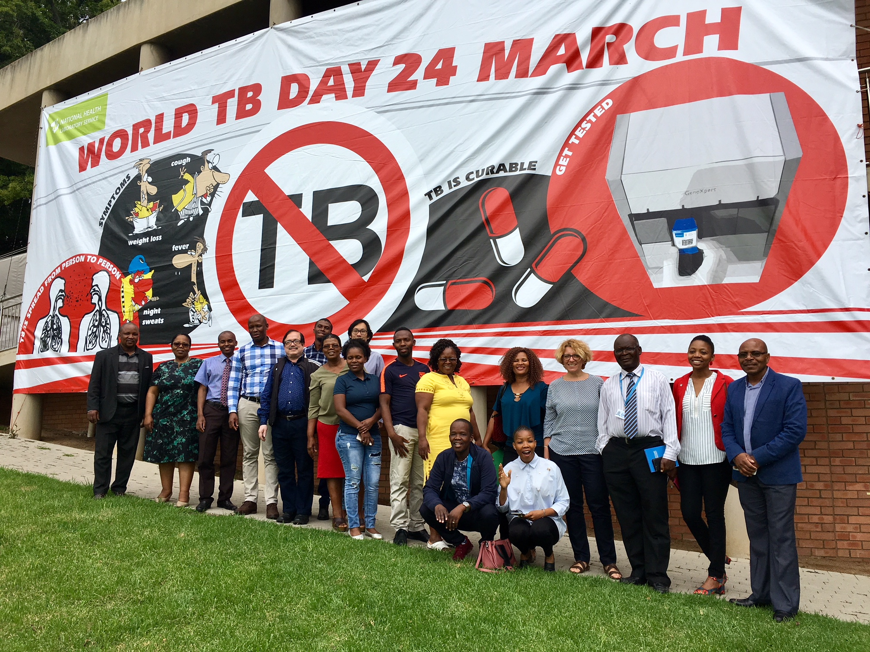
Study tour of South Africa:
Botswana, Lesotho and Swaziland

Slide 34


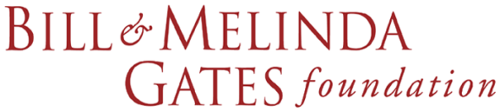
Acknowledgements
Individuals and communities who participated
All the field staff Medical Officers, nurses, interviewers, radiographers, drivers
Volunteers from the communities
Provincial Departments of Health

Slide 35
Thank you

